Slide 1
Nanopublications
15 September 2023
Tobias Kuhn

Slide 2
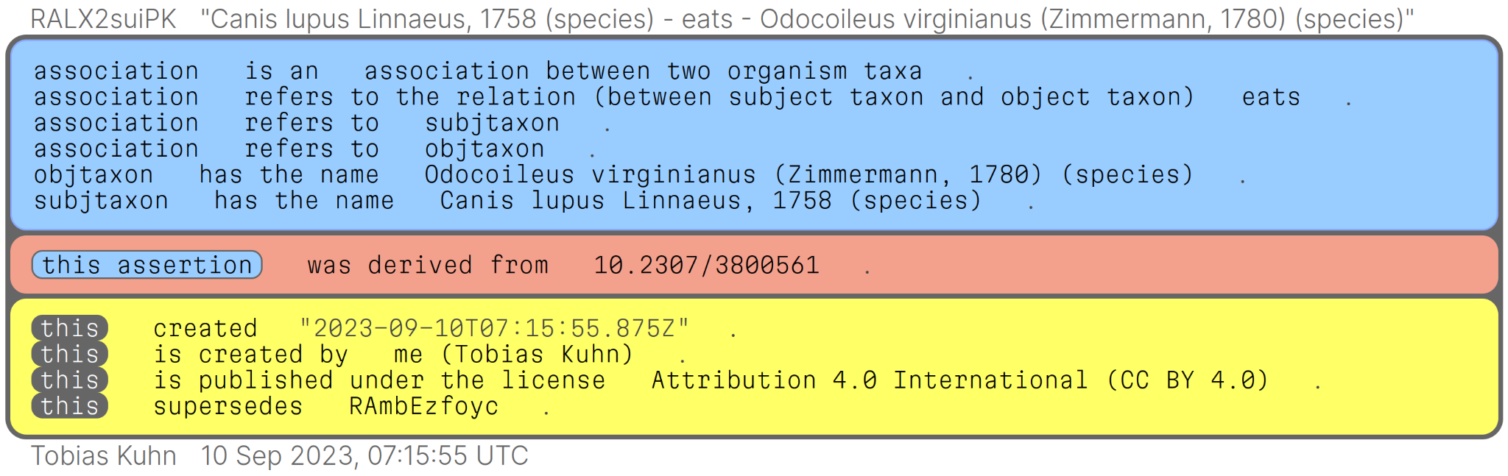
Nanopublications: tiny containers for FAIR knowledge
https://nanodash.petapico.org/ https://bdj.pensoft.net/nanopublications
(article for live demo)

Slide 3
Nanopublications: vision
Computer-interpretable formal representations of findings and their contexts as the main thing to be published (narratives as “supplemental material”)
Letting researchers directly (not through text mining etc.) build a global scientific knowledge graph
Open and inclusive (data, tooling, communities) and anti-silo
Publish first, assess quality later (post-publication review etc.)
Nanopublications as universal containers for: findings, researchers, studies, equipments, datasets, workflows, hypotheses, opinions, reviews, etc.

Slide 4
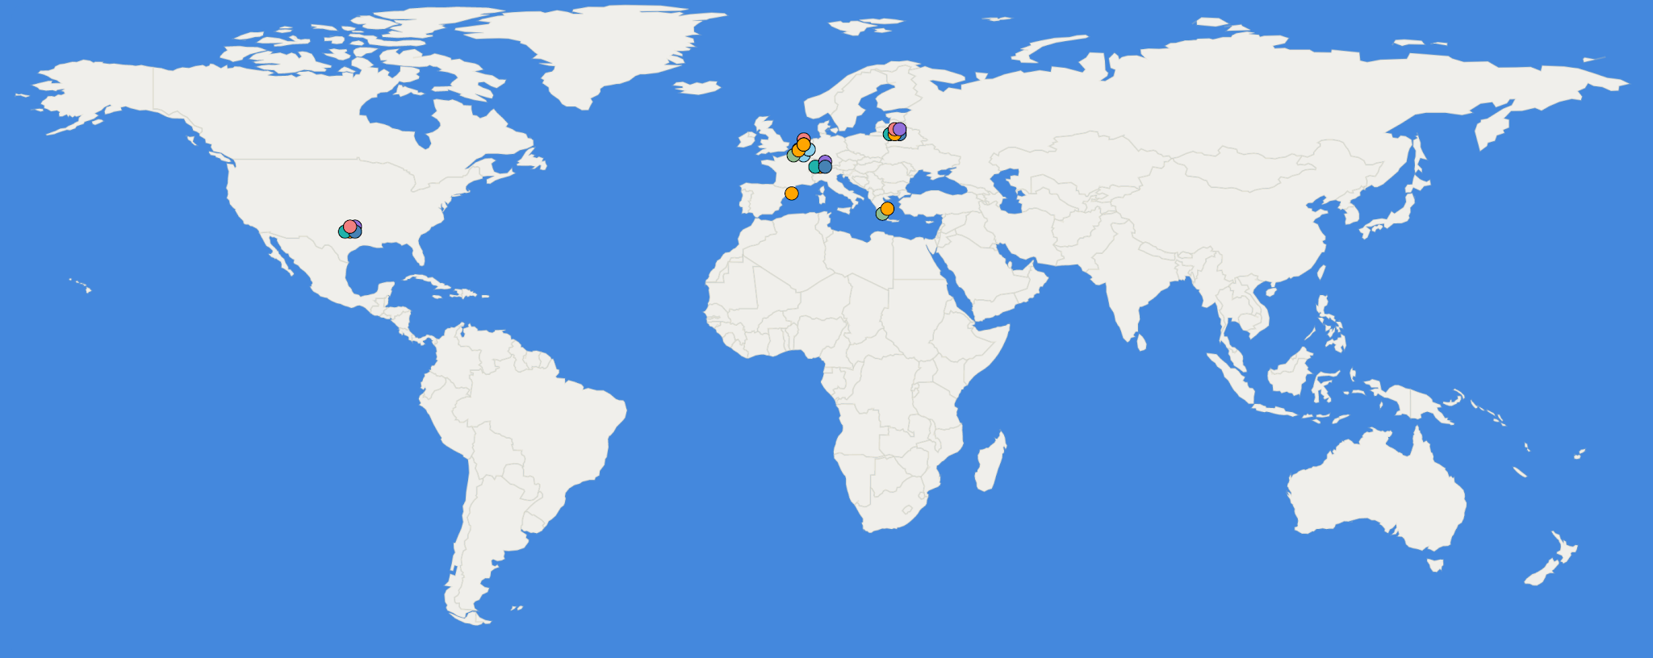
Nanopublications: ecosystem
Decentralized server network with >10M nanopublications
Has been running for more than 10 years

Slide 5

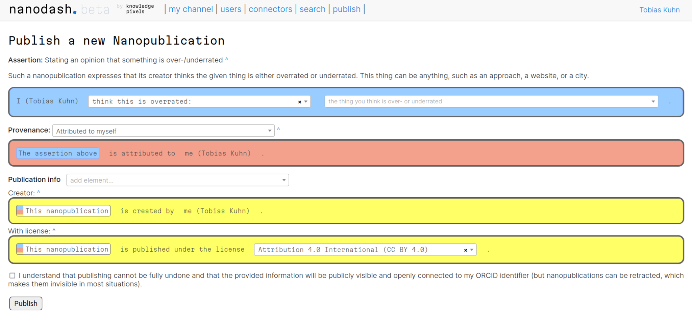
Nanopublications:
https://nanodash.petapico.org/publish?template=http://purl.org/np/RAZl6zoPE0fsmao_xKl5h1rNR2u6vib0EdBWH1FPvi11U

Slide 6
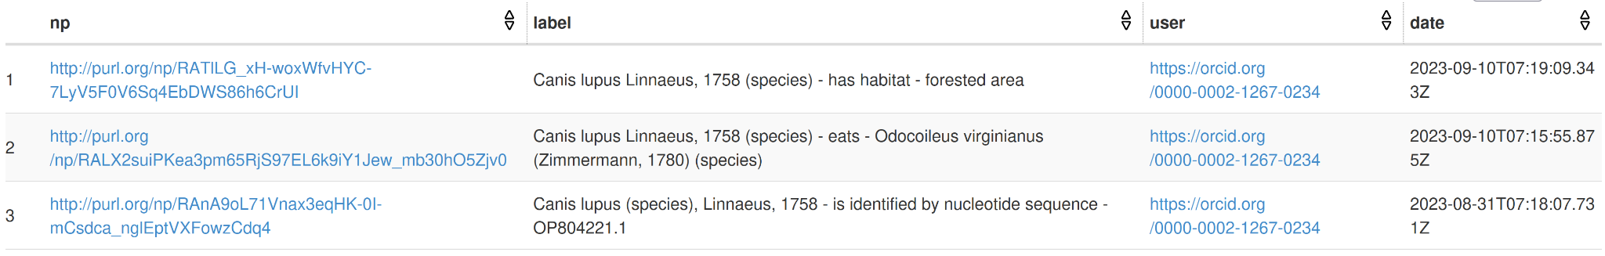
Nanopublications: live global semantic queries
For example, get all associations of species Canis lupus Linnaeus, 1758:
https://peta-pico.github.io/tapas/tapas.html?api=knowledgepixels/biodiv-example-queries&op=/get-biodiv-associations-for-subj-taxon&param_taxon=https://www.checklistbank.org/dataset/9880/taxon/QLXL&autosubmit=on
...
graph ?assertion { ?association biolink:subject ?subj .
?subj biodiv:hasTaxonName ?taxon . }
graph ?pubinfo { ?np dct:creator ?user .
?np rdfs:label ?label . }
...

Slide 7
Nanopublications
Working ecosystem for semantic publishing
Universal coverage
Designed to evolve and scale
Still cutting-edge …
… but ready to be used
E.g. in our brand-new BDJ pilot: https://bdj.pensoft.net/nanopublications
Interested? Get in touch, we are looking for use cases and trend-setting communities :)

