Slide 1
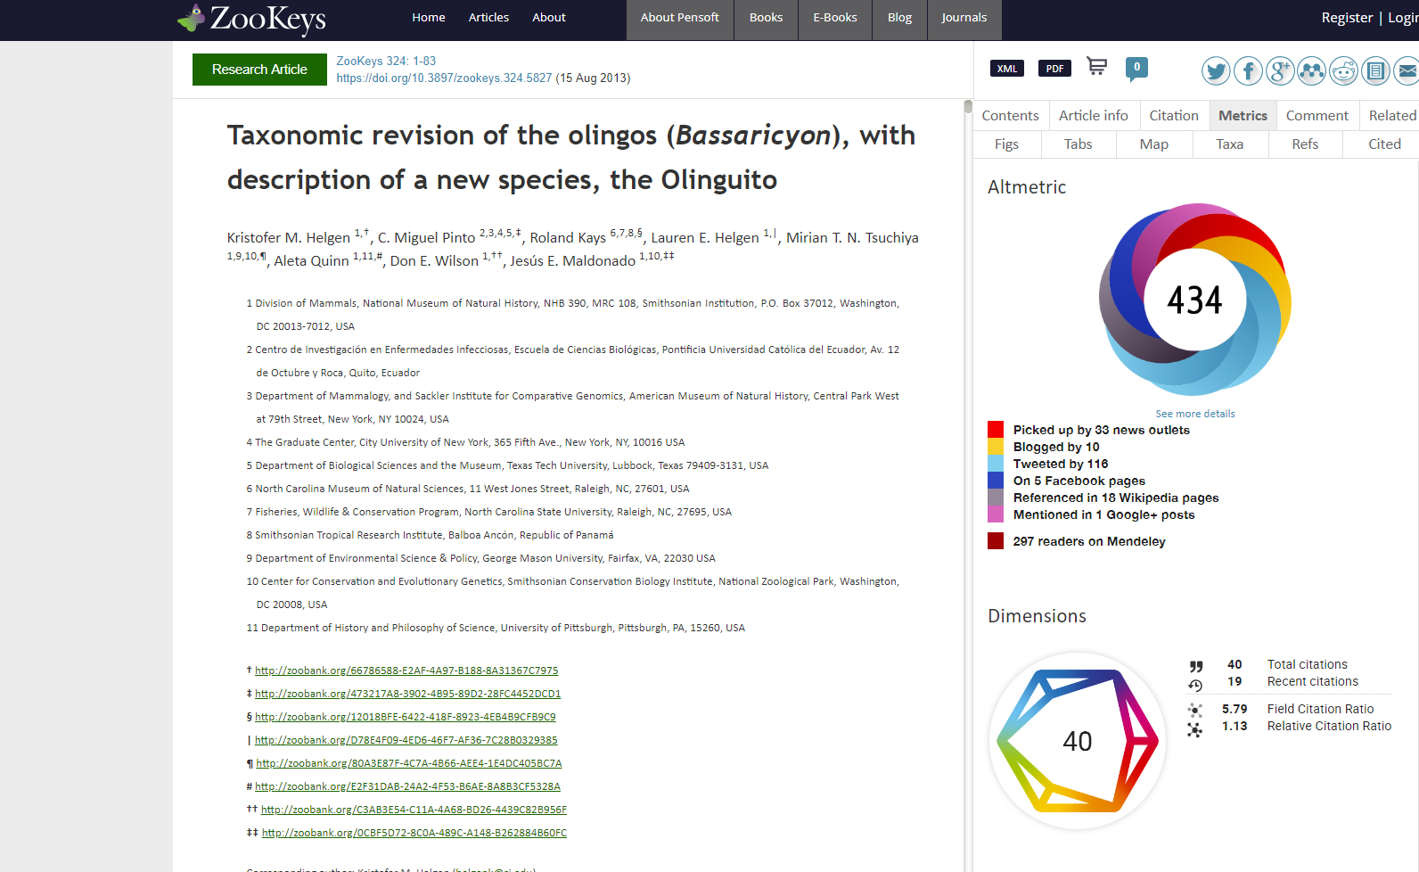
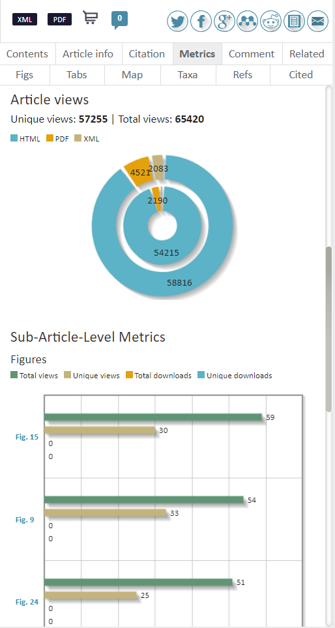
Multiple usage metrics on article- and sub-article level

Slide 2
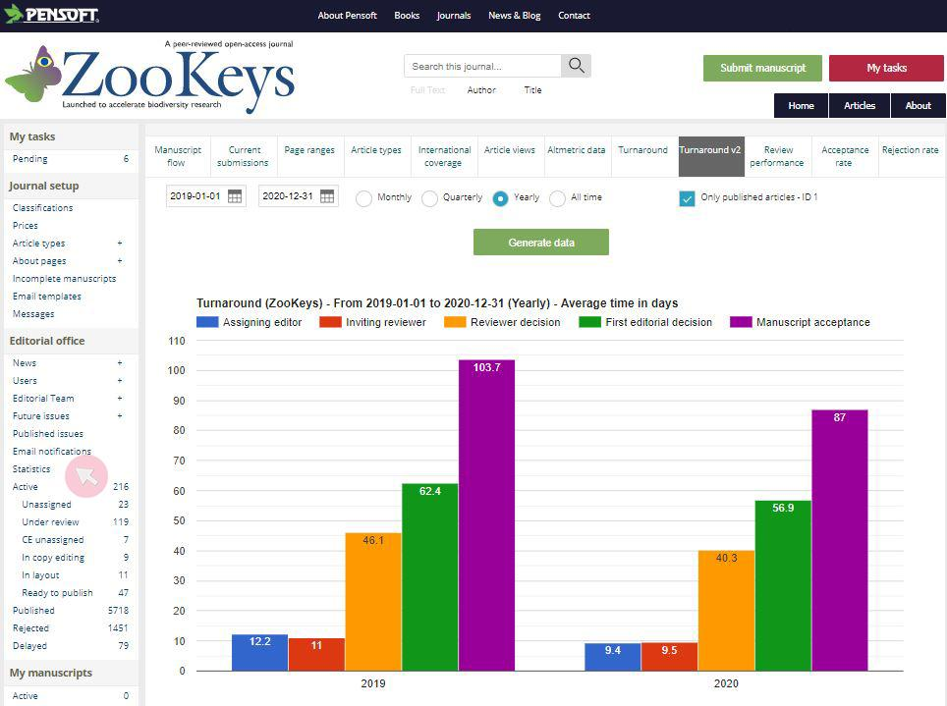
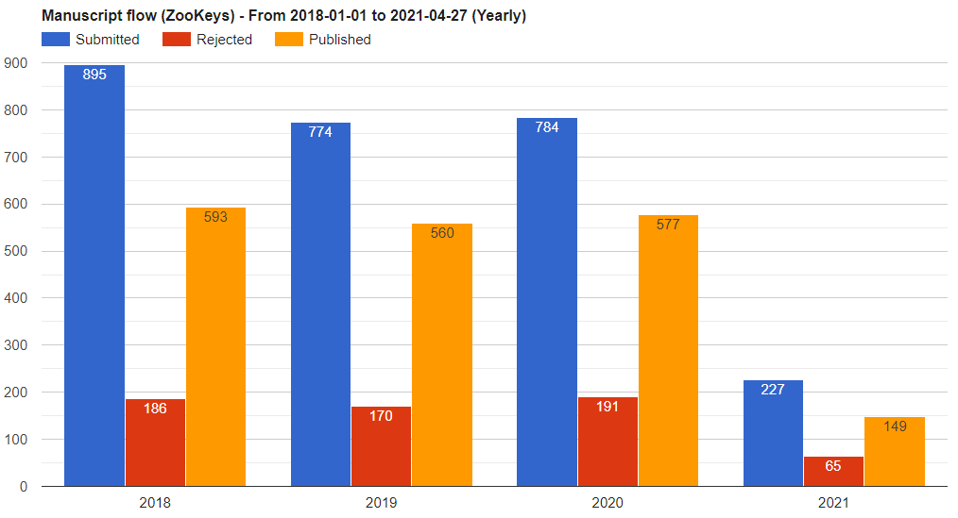
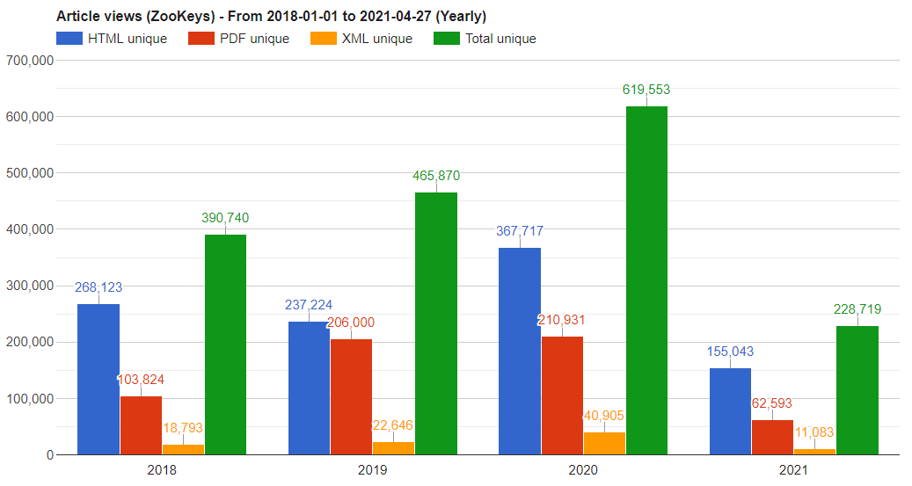
Various journal statistics available to Managing editors

Slide 3
Journal performance statistics and reports
Journal performance statistics includes:
manuscript submissions at any moment and their status;
publications and submissions for any period of interest;
publications by article type for a period of choice;
international representation based on lead author’s country for a period of choice;
article views for a period of choice.
Chief Editor and Managing editor can access the statistics at any time

Slide 4
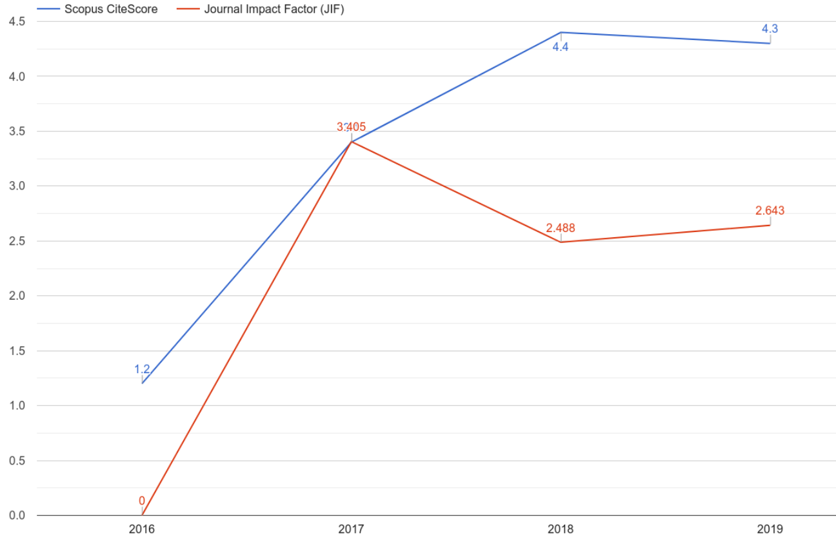
Journal performance statistics and reports
Journal performance report includes:
current submissions and their status;
submissions, publications and rejections;
acceptance rate;
turnaround times;
average review invitations, declines and review rounds;
authors by country;
article views;
online article mentions;
Journal Impact Factor and CiteScore trends.
Sent to the Chief Editors biannually

Slide 5
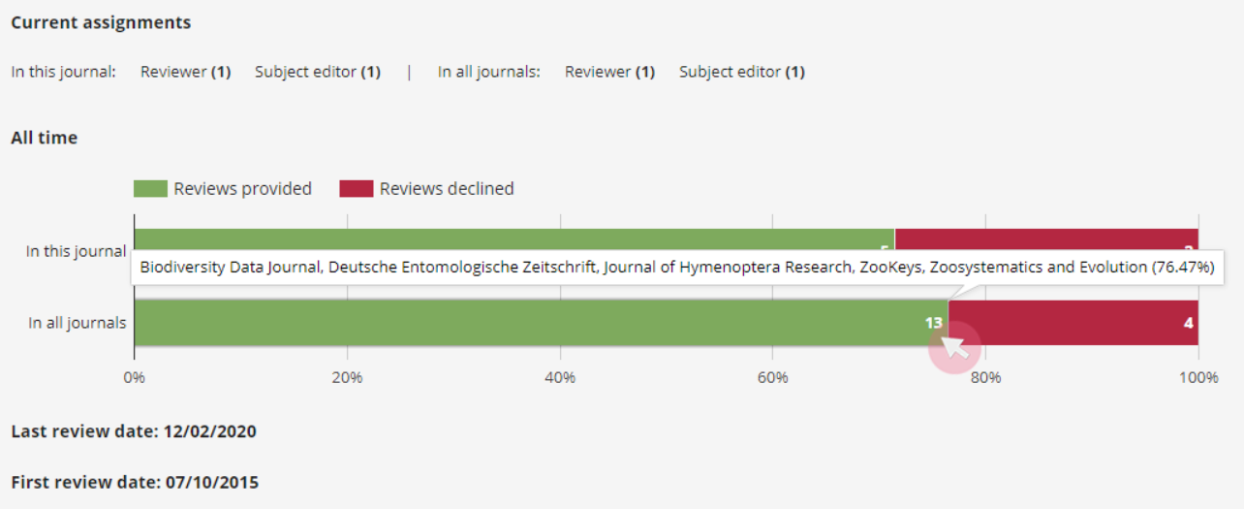
Features to manage reviewers and subject editors
See how many assignments your reviewers and subject editors have across all Pensoft journals to ensure smooth and fast review process
Track your reviewers’ and subject editors’ activity

