Slide 1
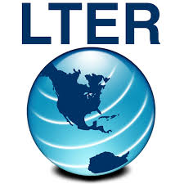
Integrated with 60+ leading indexing and archiving databases

