Slide 1
White-label and (co-)publishing
With ARPHA, a journal or conference can operate under its own logo and imprint
OR
be (co-)published with Pensoft to benefit from recognition, promotion and development as part of the publisher’s portfolio.

Slide 2
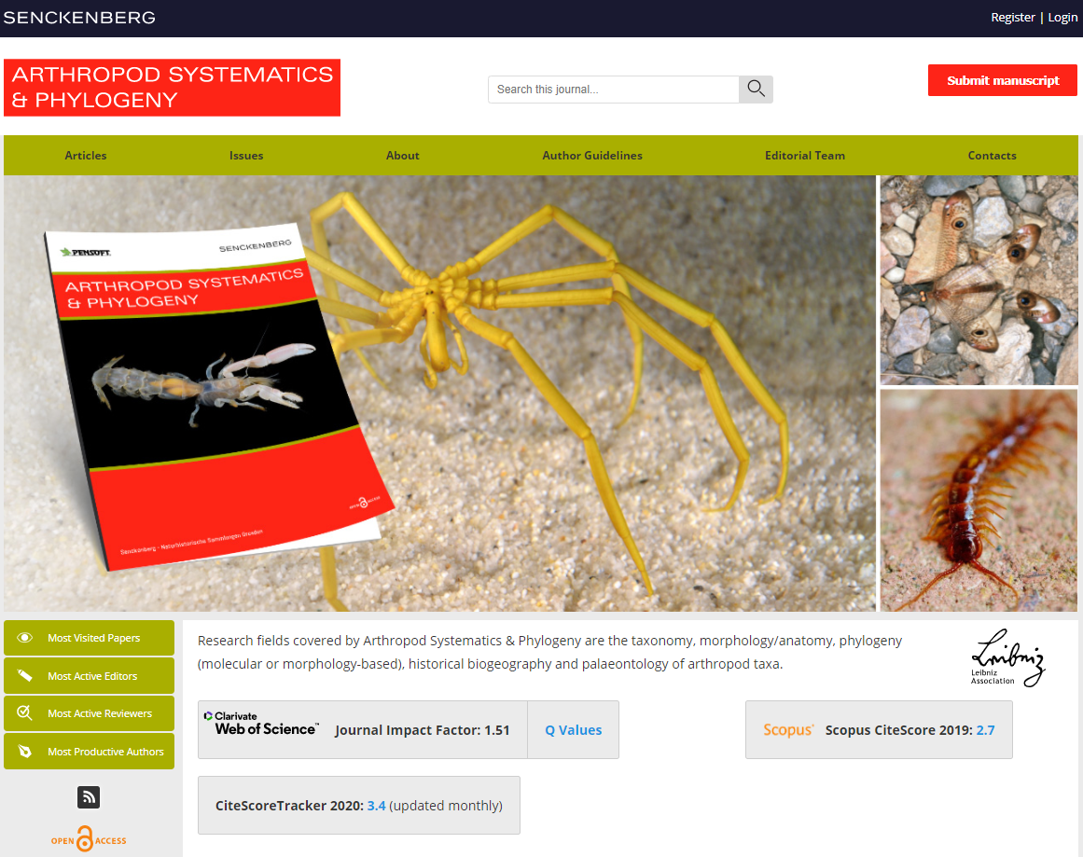
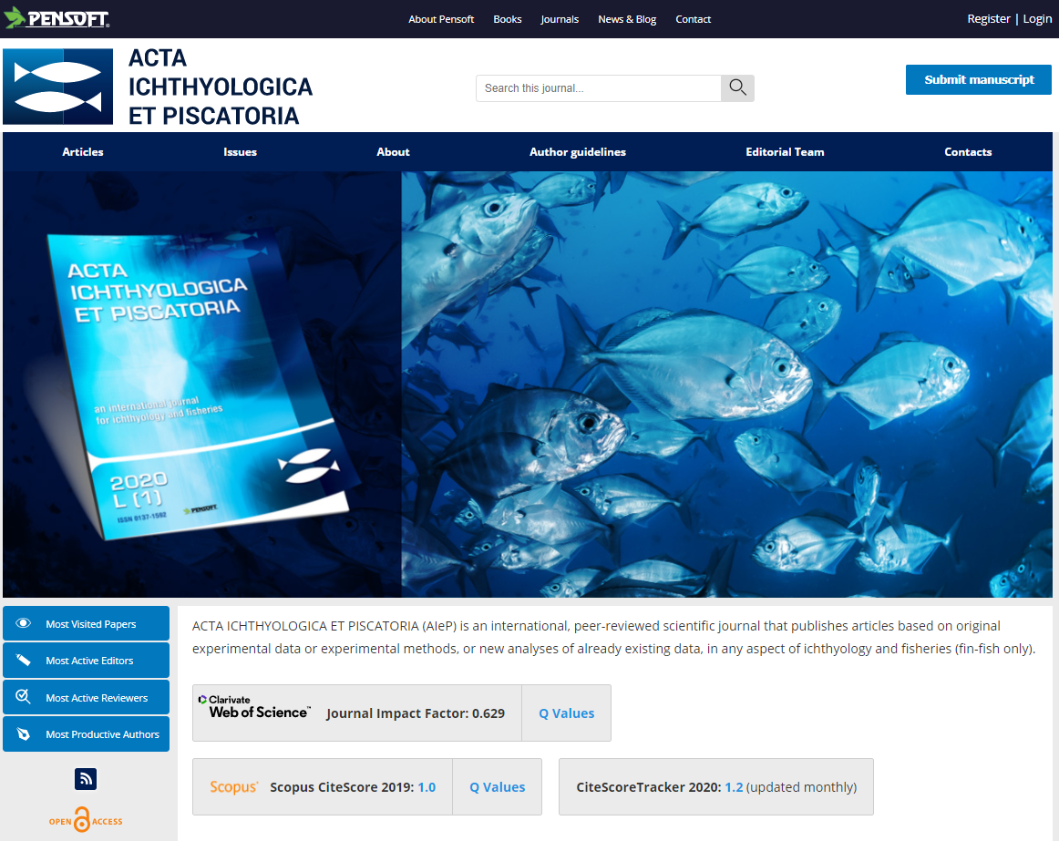
Example: White-label ARPHA-hosted or co-published journal
https://arthropod-systematics.arphahub.com/
https://aiep.pensoft.net/

