Slide 1
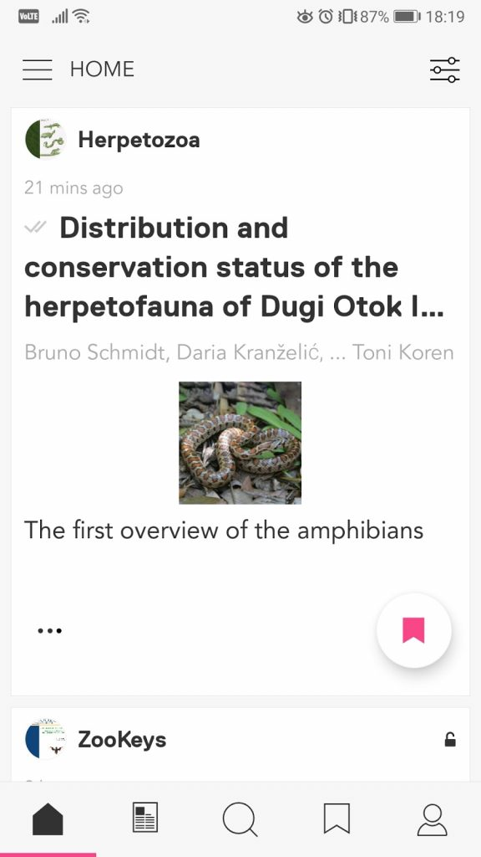
Going mobile: Integration with research discovery app Researcher
A new integration with a mobile app Researcher allows readers to receive the latest articles from Pensoft journals straight to their smartphone
Researcher: an innovative mobile and web application, currently used by 1.8 million people globally, which allows you to set up your own social media-style feed of research papers by following your favourite academic journals or research topics.

